Slide 1


End of study internship project:
Telecommunications National Engineering Degree
Major : AIM
Text-graph Convolutional Neural Network for negative news classification
Realized by:
AYED Houssem
Supervised by:
Mr. BOUBAKER Nejib (SUP’COM)
Mr. ABDELLAOUI Houssem (EQUALIOS)
Academic year: 2019 - 2020

Slide 2







Plan
Host company presentation
Project Context & Problem « Negative News Classification »
Solution: Text-SGCN model
Project Pipeline & Implementation
Results
Conclusion & Perspectives

Slide 3

Host company presentation
3

Slide 4
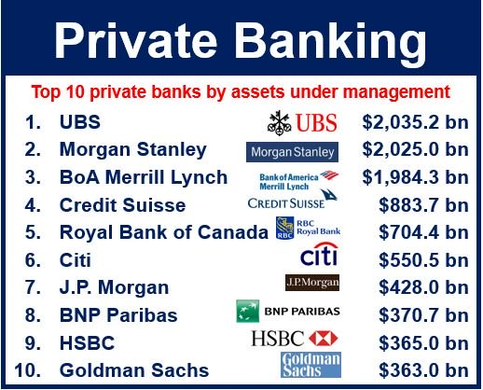






EQUALIOS
Business consulting services in the field of regtech
Development of technological solutions for KYC/AML problems
Host company presentation
4

Slide 5
Project Context & Problem
« Negative News Classification »
5

Slide 6



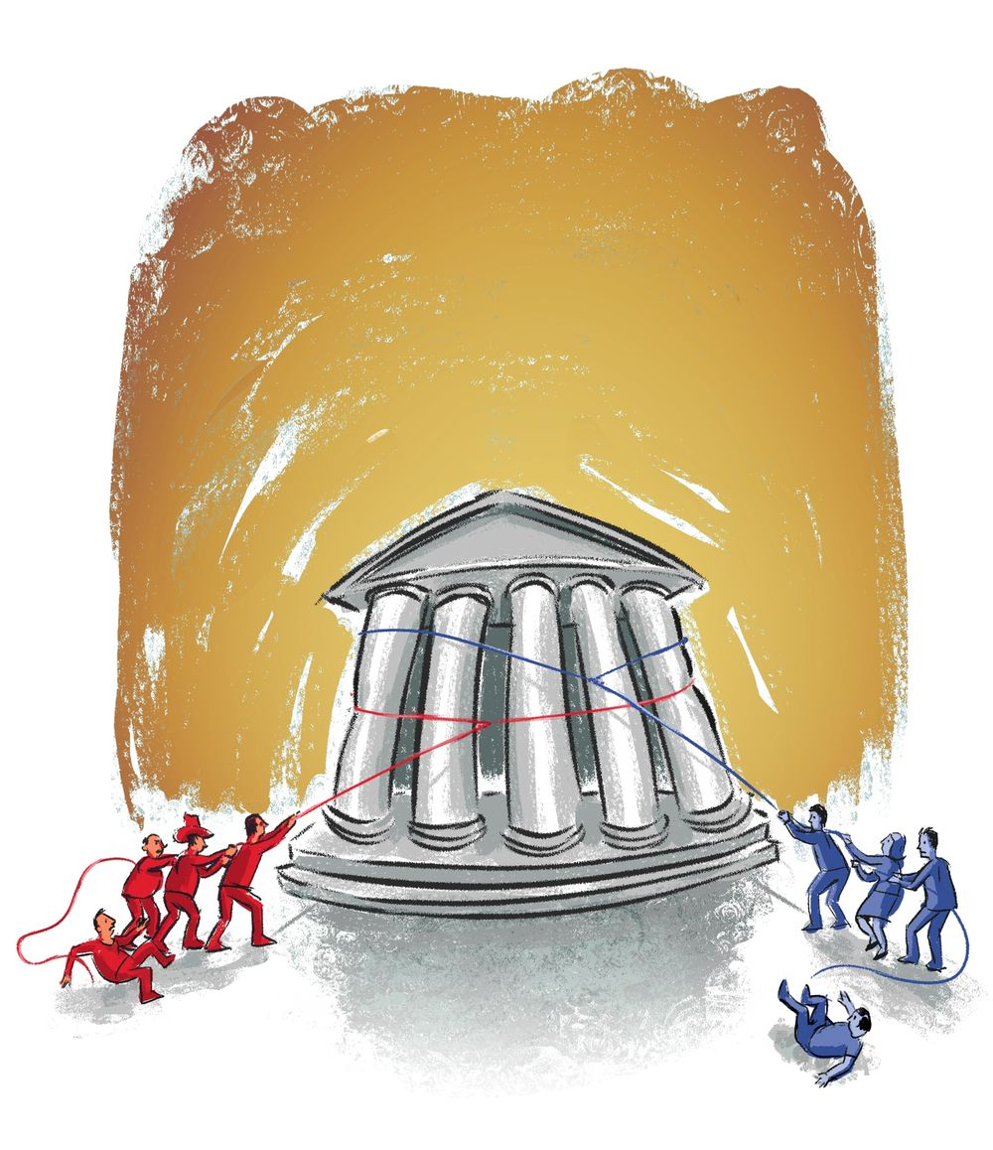




Project Context
1aaaaaaaaaaaaaaaaaa
frauds
Terrorism financing
Money laundering
…
Banks
Project Context & Problem « Negative News Classification »
6

Slide 7






KYC (Know Your Customer) for banks
Project Context & Problem « Negative News Classification »
7

Slide 8
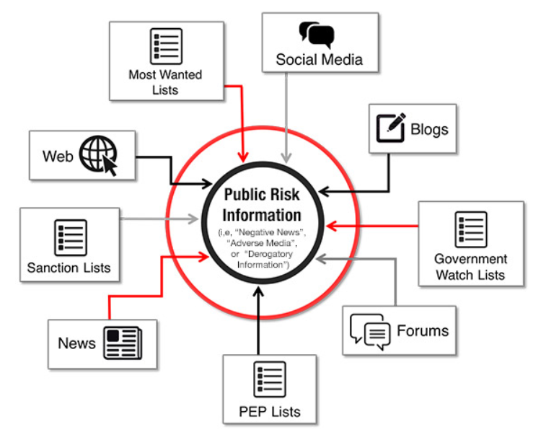

Problem “ Negative News
Classification ”
Project Context & Problem « Negative News Classification »
8

Slide 9

Solution: Text-SGCN
model
9

Slide 10
State of the art solutions for text classification “News”
 | 20NG | R52 | Ohsumed | MR
Number of articles | 18,846 | 9,100 | 7,400 | 10,662
Number of classes | 20 | 52 | 23 | 2
Average length | 221.26 | 69.82 | 135.82 | 20.39
Models performances (Test accuracy %)
TF-IDF + LR [Zhixiang (Eddie) Xu, Minmin Chen] | 83.19 | 86.95 | 54.66 | 74.59
CNN [Yoon Kim] | 82.15 | 87.59 | 58.44 | 77.75
LSTM (pretrain) [Pengfei Liu, Xipeng Qiu, Xuanjing Huang] | 75.43 | 90.48 | 51.10 | 77.33
Text GCN [Liang Yao, Chengsheng Mao, Yuan Luo] | 86.34 | 93.56 | 68.36 | 76.74
1aaaaaaaaaaaaaaaaaa
Solution: Text-SGCN model
10

Slide 11
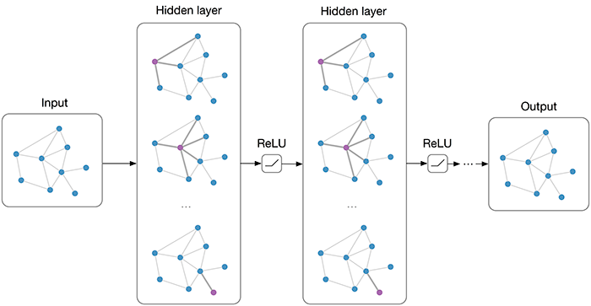
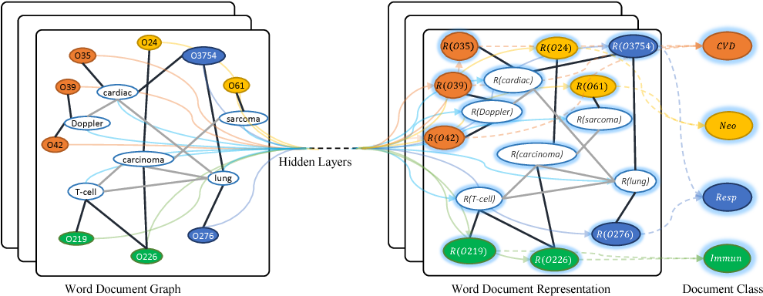

Text-GCN model
1aaaaaaaaaaaaaaaaaa
Solution: Text-SGCN model
11

Slide 12
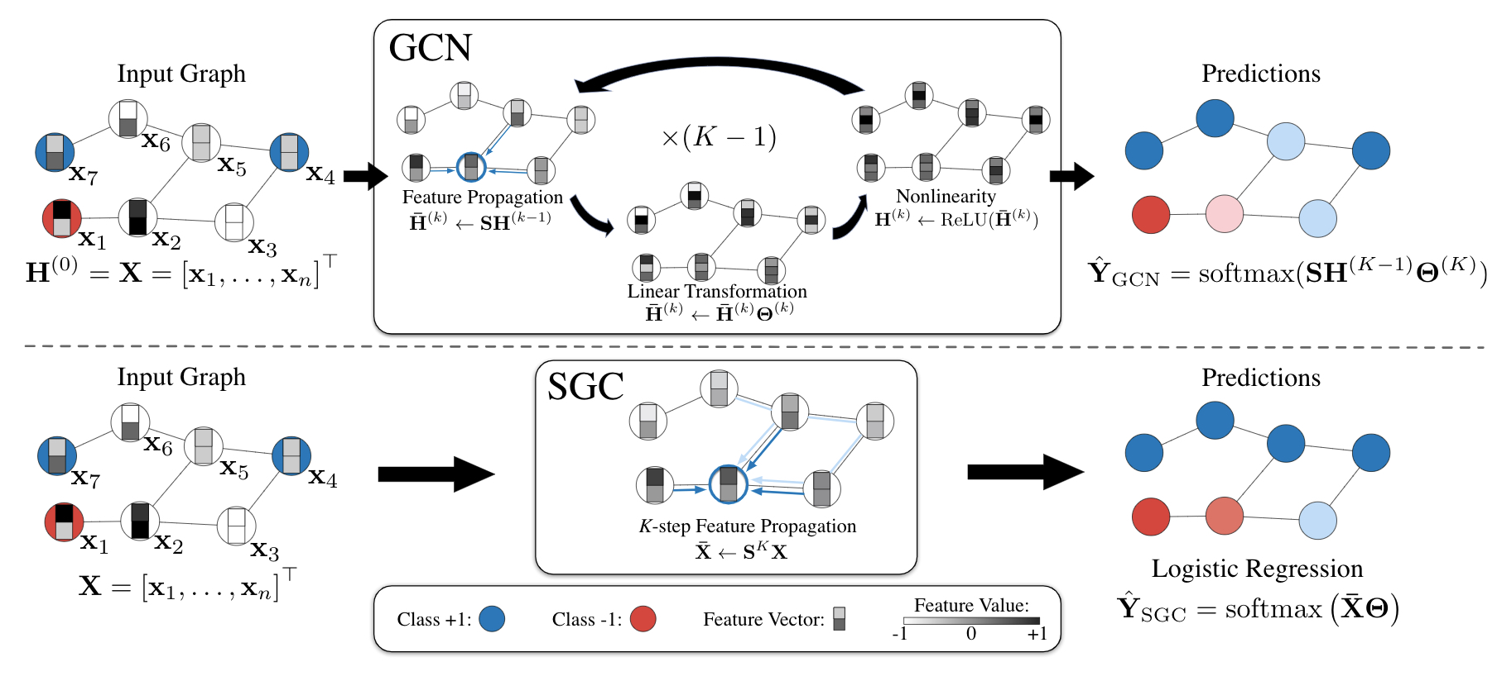



Architecture of SGCN model compared to GCN
12
Solution: Text-SGCN model

Slide 13
Project pipeline
& Implementation
13

Slide 14








Project pipeline
Predictions
Cleaning
process
Graph
construction
Features
computation
Logistic
regression
Collected
documents
Visualizations
Features
initialization
Project pipline & Implementation
14

Slide 15
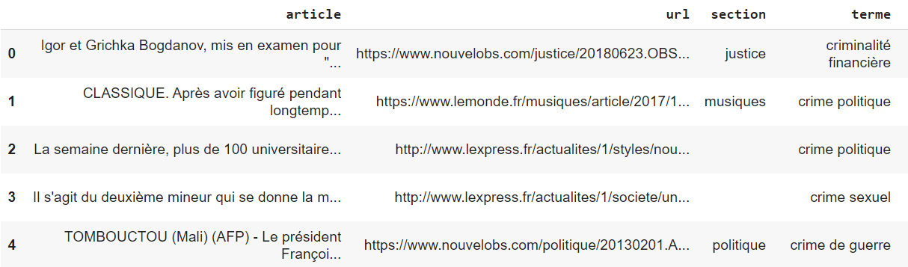
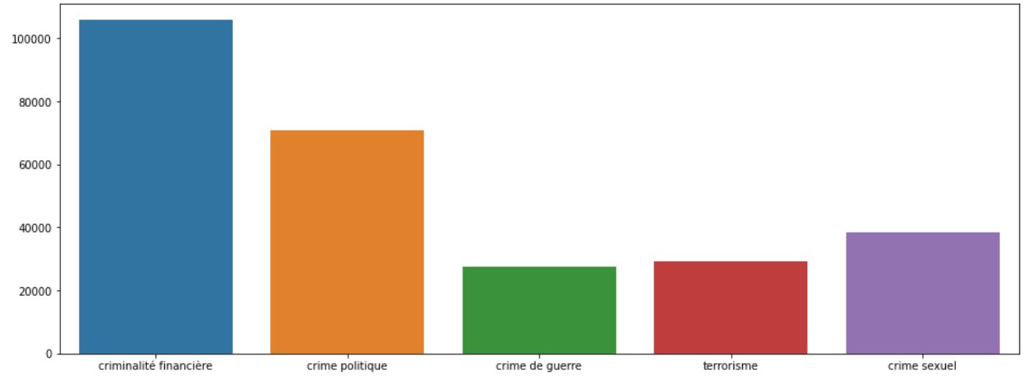
Collected documents
Number of documents | 293K
Number of classes | 5
Average length of a document | 482
Number of distinct words (Vocab size) | 553371844
Number of articles per class
Project pipline & Implementation
15

Slide 16
Documents cleaning
Raw text
Noisy characters removal
Tokenization
Stopwords + punctuation removal
Lemmatization
Cleaned & Preprocessed text
Project pipline & Implementation
16

Slide 17
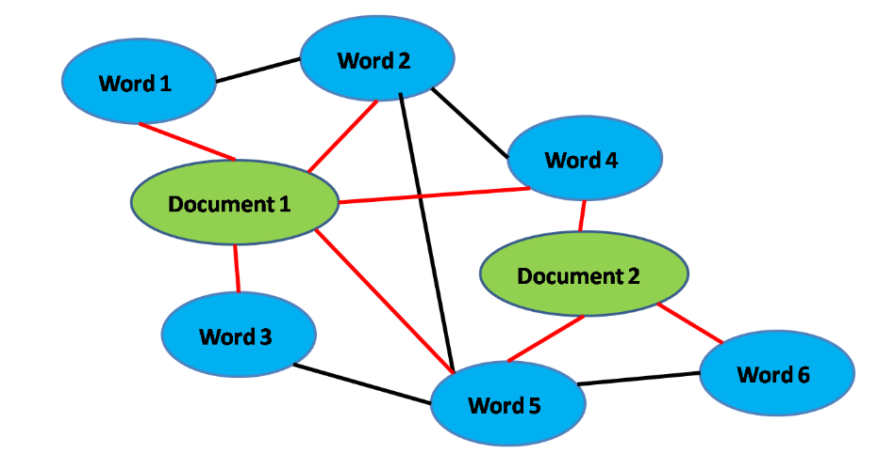
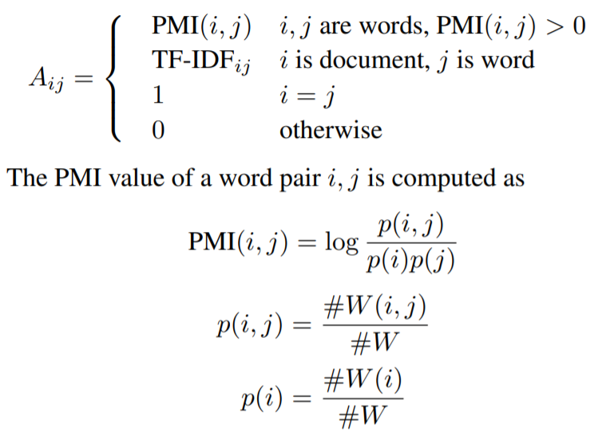

Graph construction
Project pipline & Implementation
176

Slide 18
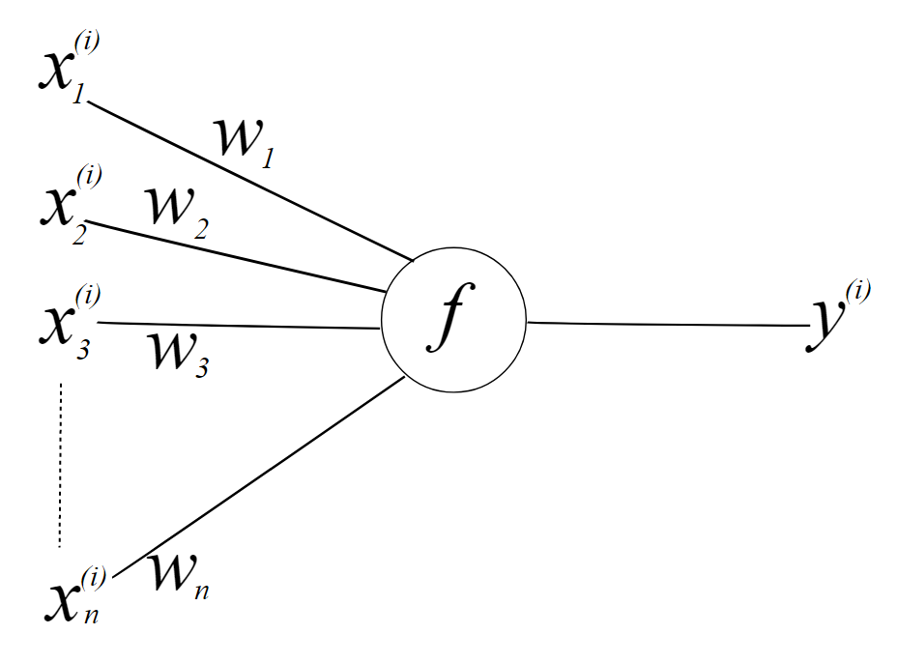

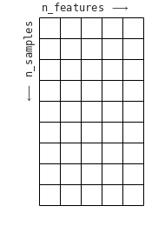

Features computation & Logistic regression
Computed
features
Matrix
X
A: Adjacency matrix
X: initialized features matrix
k: depth
Project pipline & Implementation
18

Slide 19
Results
19

Slide 20

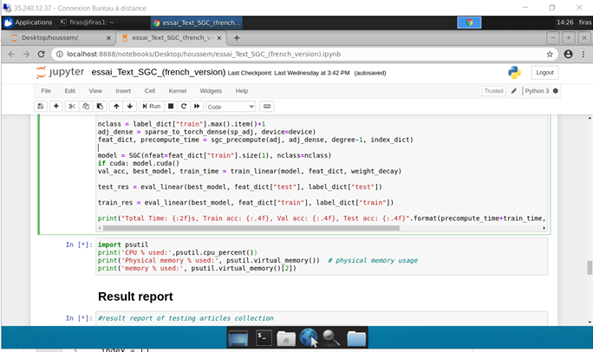









Environment
1aaaaaaaaaaaaaaaaaa
20
Results

Slide 21
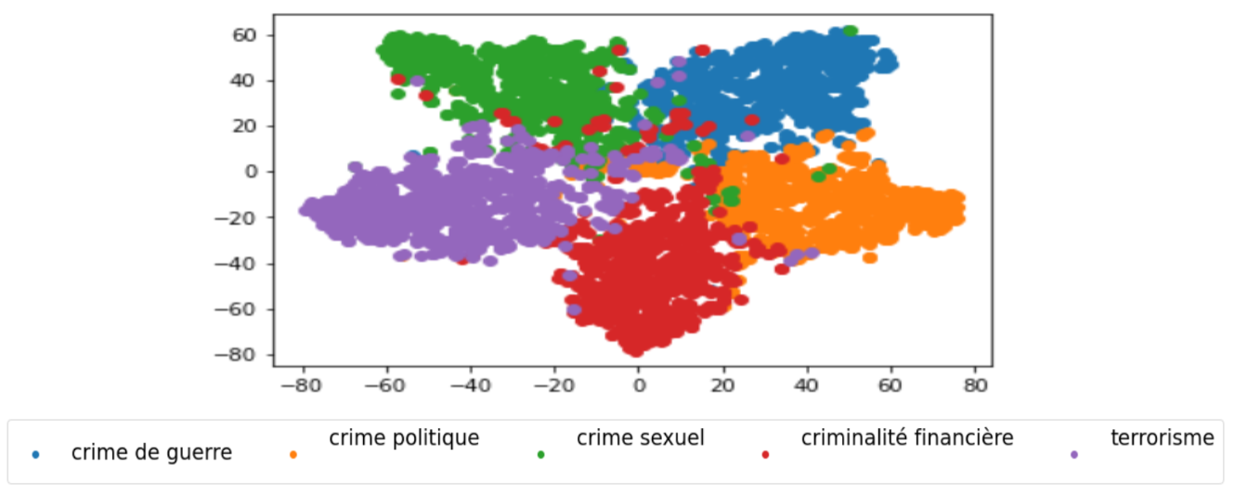
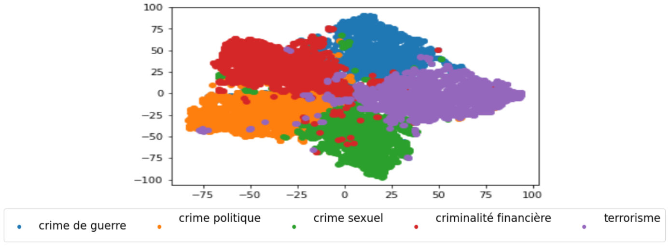
Results report and visualizations
Performances report on test documents
Crime | Precision | Recall | F1-score | Support
sexual | 82.76 | 80.27 | 81.49 | 2488
political | 72.20 | 80.36 | 76.07 | 2266
financial | 77.01 | 74.93 | 75.96 | 2361
terrorism | 74.45 | 74.52 | 74.48 | 2327
war | 70.03 | 66.44 | 68.19 | 2318
Accuracy | 75.35
1aaaaaaaaaaaaaaaaaa
Train documents embeddings
Test documents embeddings
21
Results

Slide 22
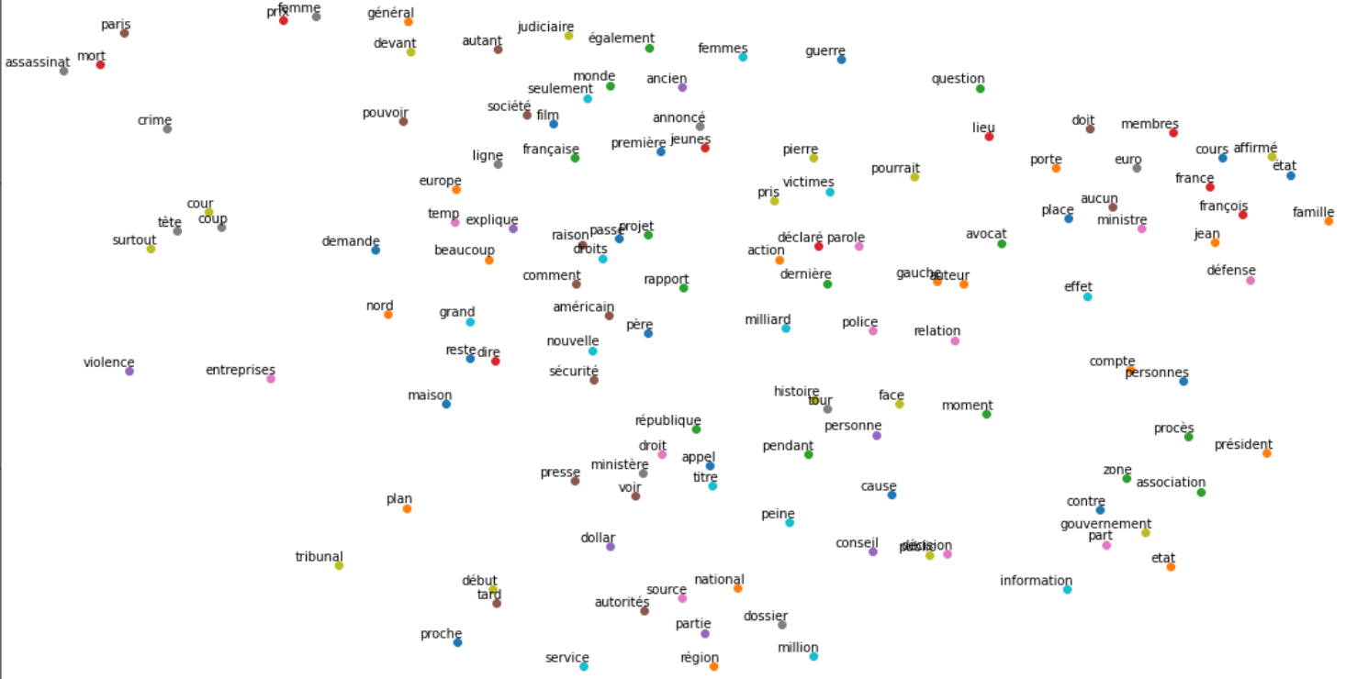
Results report and visualizations
1aaaaaaaaaaaaaaaaaa
22
Results

Slide 23




Conclusion
Classification precision of 83% on train documents and about 75% on test documents
Producing nodes embedding (Words + Documents)
Huge use of memory about 83 GB
Not suitable for real time applications
1aaaaaaaaaaaaaaaaaa
23
Conclusion & Perspectives

Slide 24


Perspectives
Features extraction block for other models
Introduce a mechanism for adapting the model for real time applications
1aaaaaaaaaaaaaaaaaa
24
Conclusion & Perspectives

Slide 25

Thanks for your attention ☺ !

